Slide 1
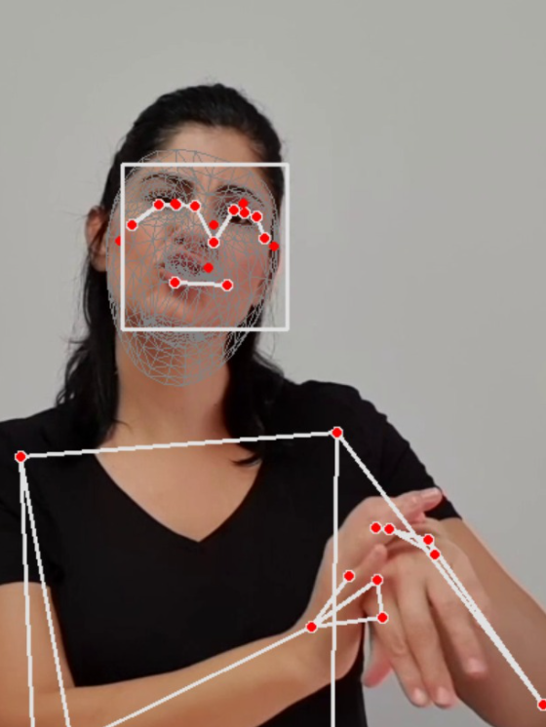
f1: X,y,z
f2: X,y,z
f3: X,y,z
fn: X,y,z
f1: X,y,z
f2: X,y,z
f3: X,y,z
fn: X,y,z

Slide 2
f1: X,y,z
f2: X,y,z
f3: X,y,z
fn: X,y,z
f1: X,y,z
f2: X,y,z
f3: X,y,z
fn: X,y,z
Can create for any {I,j,k…} combination
Ratio is only 1 example

Slide 3
7.3
Approaches:
1. openface -> AU’s
2. use openface to generate data to train a classifier to map media pipe’s landmarks to Au’s
End goal:
Use AU’s to determine significant features in singers
How much those Au’s are affected by speech

Slide 4
Open face AU
The system can detect the intensity (from 0 to 5) of 17 AUs:
AU01_r, AU02_r, AU04_r, AU05_r, AU06_r, AU07_r, AU09_r, AU10_r, AU12_r, AU14_r, AU15_r, AU17_r, AU20_r, AU23_r, AU25_r, AU26_r, AU45_r
And the presence (0 absent, 1 present) of 18 AUs:
AU01_c, AU02_c, AU04_c, AU05_c, AU06_c, AU07_c, AU09_c, AU10_c, AU12_c, AU14_c, AU15_c, AU17_c, AU20_c, AU23_c, AU25_c, AU26_c, AU28_c, AU45_c

Slide 5
14.3
Approaches:
1. openface -> AU’s
2. use openface to generate data to train a classifier to map media pipe’s landmarks to Au’s
Goals:
Use AU’s to determine significant features in singers
How much those Au’s are affected by speech
Find differences between the 5 emotions in terms of AU’s / dominant features
Features - Avg, std of au intensity, au event driven : X frames (threshold (use natural to set )– 1 second sliding window) with an AU occurred “a lot”. Break sentence to 3 segments (3rd of video length)
For each AU 5 features – avg, std, 3 #amount of events
Check if Aus respond the same w and w/o talking
Action items :
Send Rose an csv example – angry1.mp4
Convention of file names: label_perId_sentenceNumber.mp4 , e.g.: angry_per1_1.mp4

Slide 6
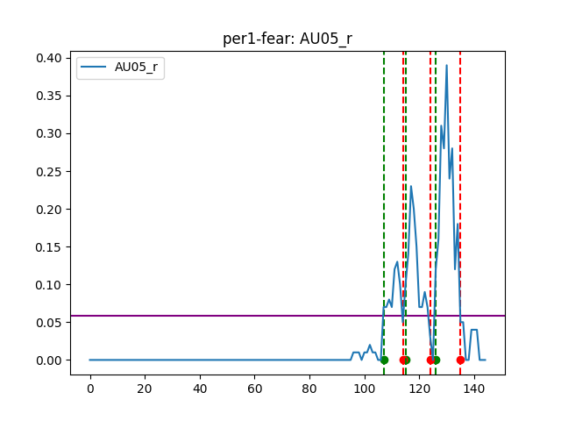
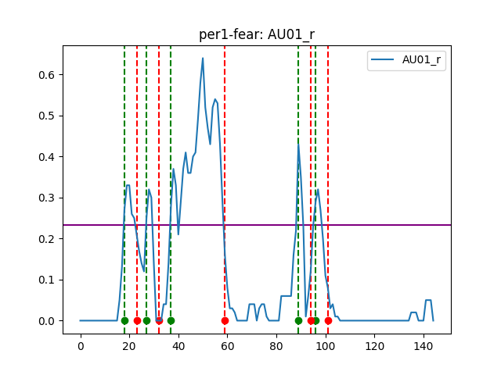
21.3
Calculating AU events based on dynamic thresholds:
Each au has diff threshold: dynamic = fix threshold * mean of au signal
Done on 3 segments per sentence (video)

Slide 7
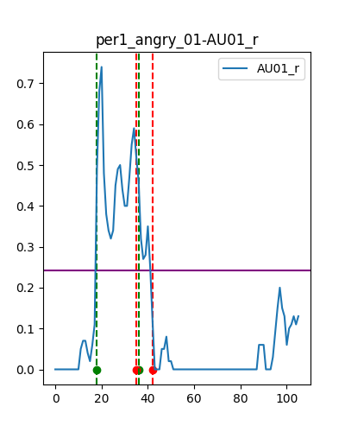
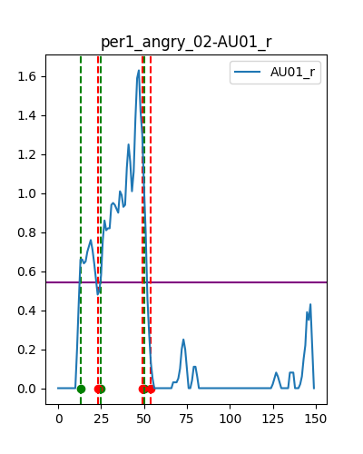
21.3
Calculating AU events based on dynamic thresholds:
Each au has diff threshold: dynamic = fix threshold * mean of au signal
Done on 3 segments per sentence (video)

Slide 8
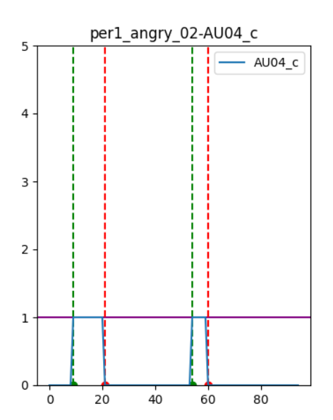
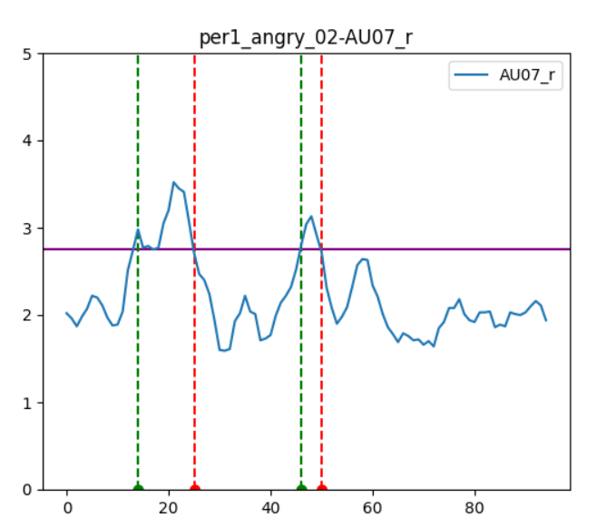
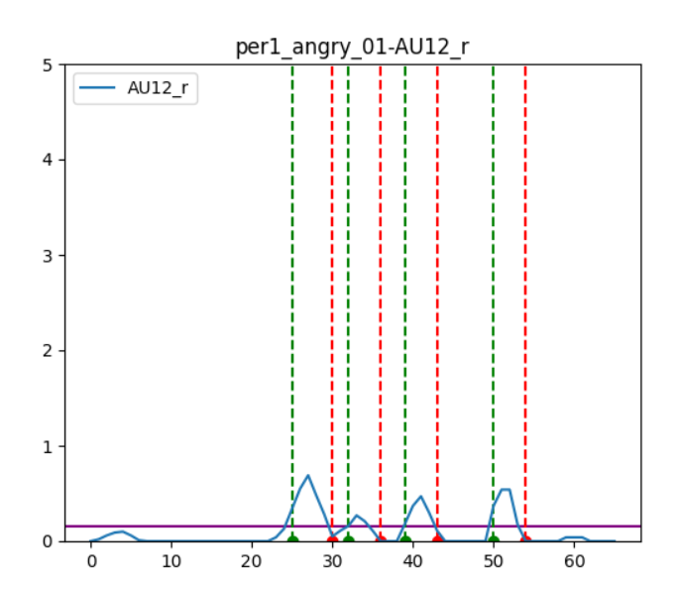
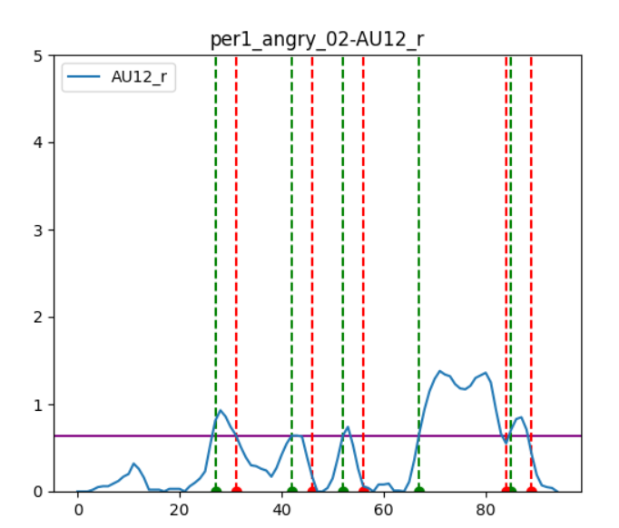
28.3
Updates:
binary aus - DONE
create csv per video - DONE
scale plots to the same y height – DONE
Intensity calculation: mean(signal[start : end]) * (end-start)
The length of the event is not counted as well as the magnitude
use window to determine the events - smooth events - NOT DONE
currently baseline is not used to determine thresholds

Slide 9
28.3-30.3
TODO:
Events
symmetric around the event (4 frames before and after)
Threshold for all the angry / fear vids , per AU
-5 plots in a graph – per au per video
-1 csv result file per video – include all labels
-Head, shoulder movement
Events based on binary alone au’s
-Predict emotion label based on those features

Slide 10
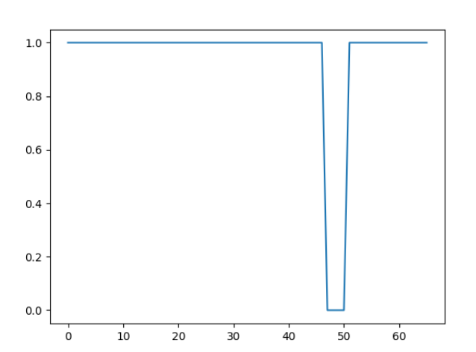
28.3
Hard cases to determine events:
Should the long event counted as e0 or e1 or both?
Au4_c – angry_01

Slide 11
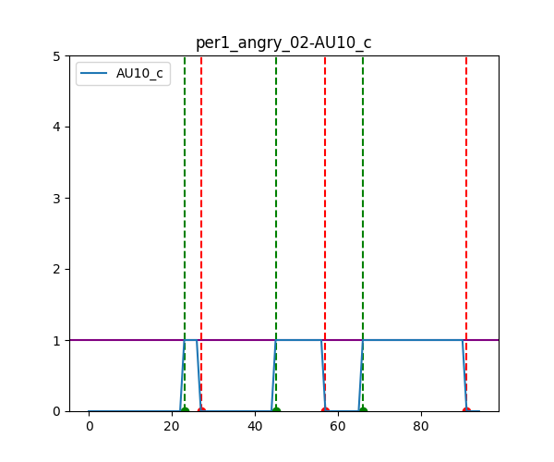
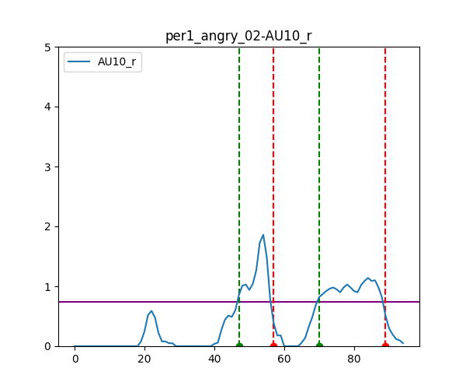
4.4
Events
Determine events based on binary signal
On every window of a binary output, go to the none binary – the signal, window and get:
length, count, (avg, std intensity)
(edge case – if there is one 0 ignore it (1,1,1,1,0,1,1,1,1))

Slide 12
25.4
Updates:
Events are now extracted using the binary signal
For exploration purpose: 1 csv per video / sentence + mean of all videos
Preprocess all data as a feature vector for ML – each row is a video / sentence:
SIZE: num of videos X features
Features per au : [mean, std, e0_length, e0_amount, e0_intensitiy , e1_..., e2_ … ] - total: 11
Au list: 1,2,4,5,6,7,9,10,12,15,17 – total 11
121 features = 11 AU’s x 11 features
50 rows – 50 videos of per 1
label | Au1_mean | Au1_e0_intensitiy | … | Au17_e2_length
Sad
angry
Check Tree on subsampling the data:
Subsample labels : e.g: fear vs neutral (each vs neutral), fear vs angry, fear vs sad,
Subsample features – ignore e1 and mean and std, compare e0 vs e2
Roni videos

Slide 13
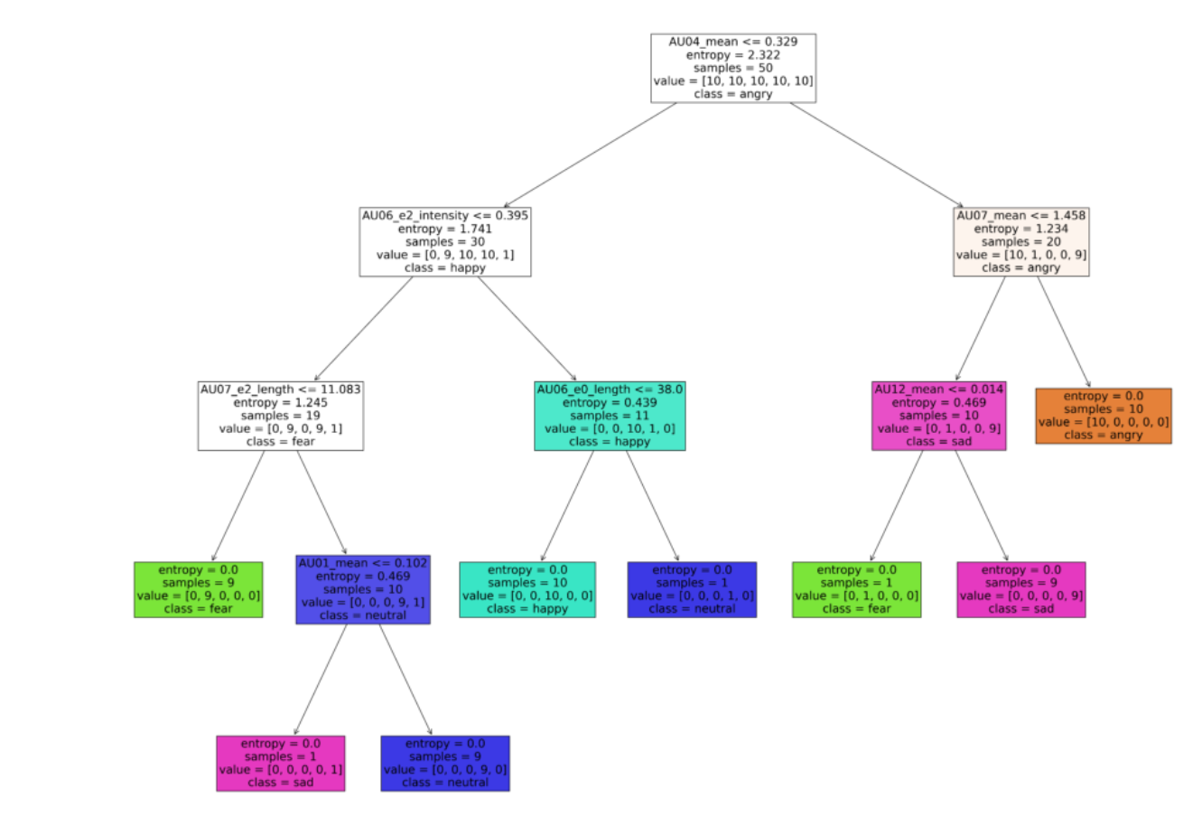
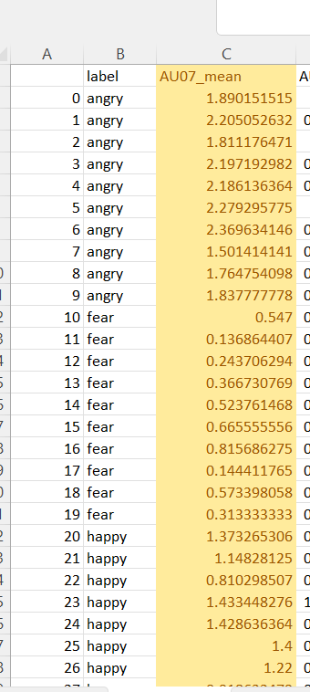
25.4
Some basic classification tells us
Which are the strong features:
AU’s: 1, 4, 7, 6, 12
Notes:
Example of training the tree on PER1 data – 50 vids

Slide 14
11.5
None hearing – classification using all features:
CV mean results: 0.78
AU’s: 1, 4, 7, 6, 12
Notes:
Example of training the tree on PER1 data – 50 vids

Slide 15
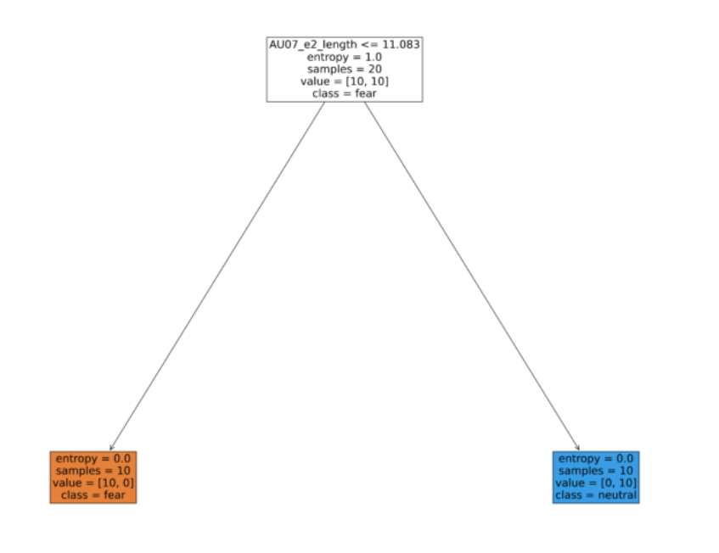
11.5
None hearing – classification using fear vs neutral:
CV mean results: 0.9
AU’s: 7
Notes:
Example of training the tree on PER1 data – 50 vids

Slide 16
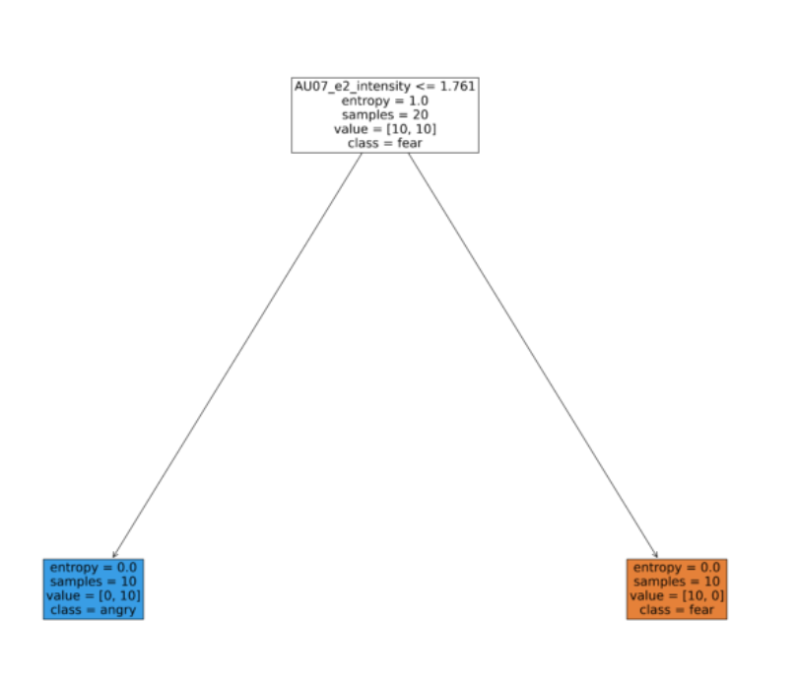
11.5
None hearing – classification using fear vs angry:
CV mean results: 0.95
AU’s: 7
Notes:
Example of training the tree on PER1 data – 50 vids

Slide 17
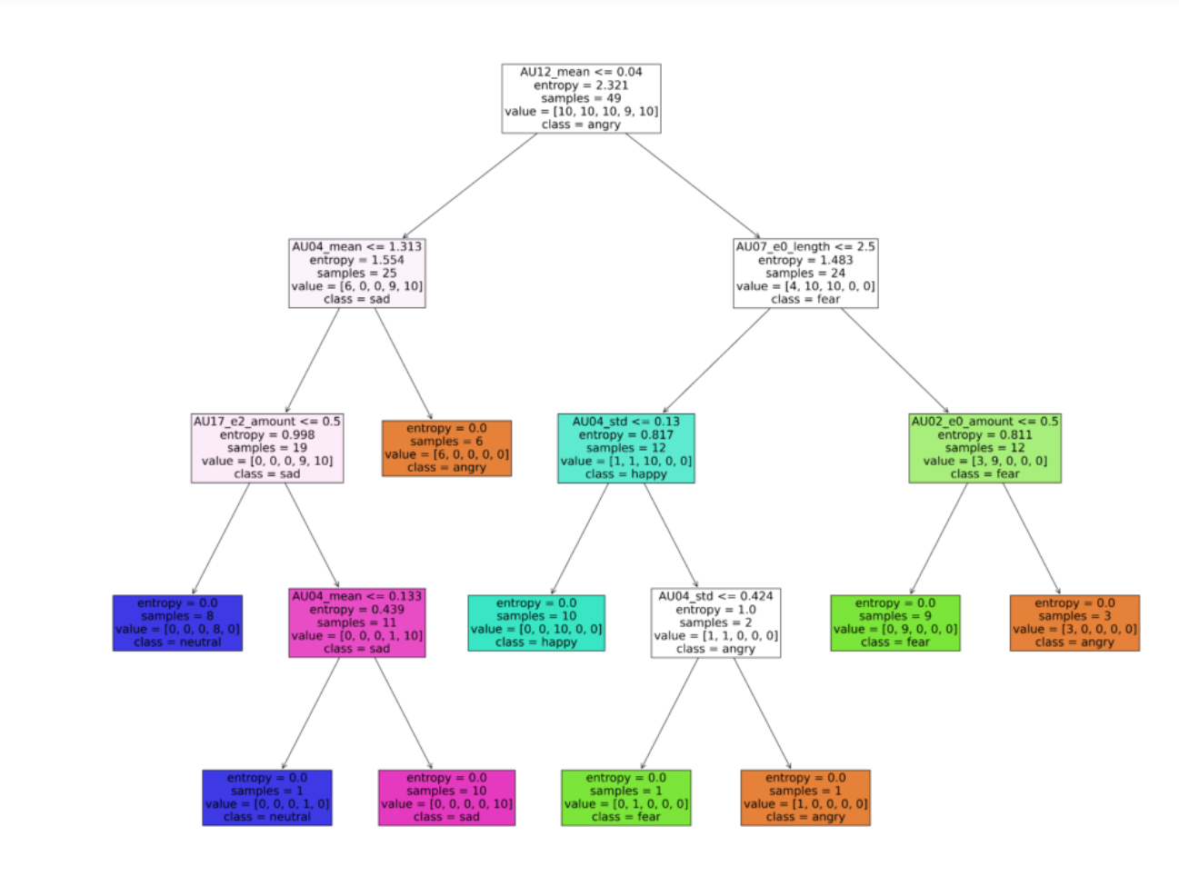
11.5
Hearing – classification using all features:
CV mean results: 0.64
AU’s: 2, 4, 7, 12, 17
['angry','fear','happy', 'neutral', 'sad']
Notes:
Example of training the tree on PER1 data – 50 vids
['angry','fear','happy', 'neutral', 'sad']

Slide 18
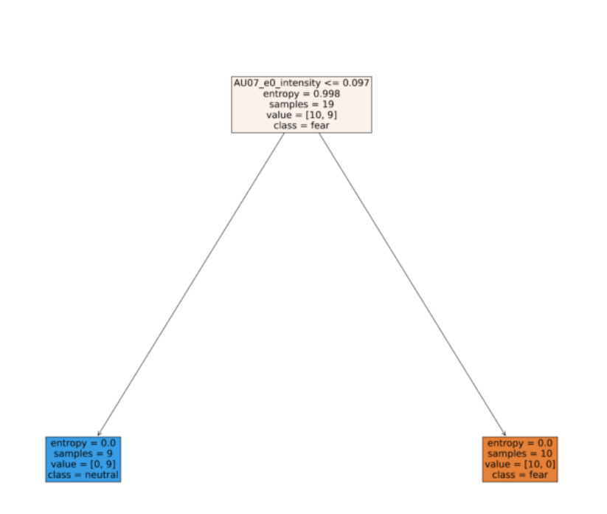
11.5
hearing – classification using fear vs neutral:
CV mean results: 0.9
AU’s: 7
Notes:
Example of training the tree on PER1 data – 50 vids

Slide 19
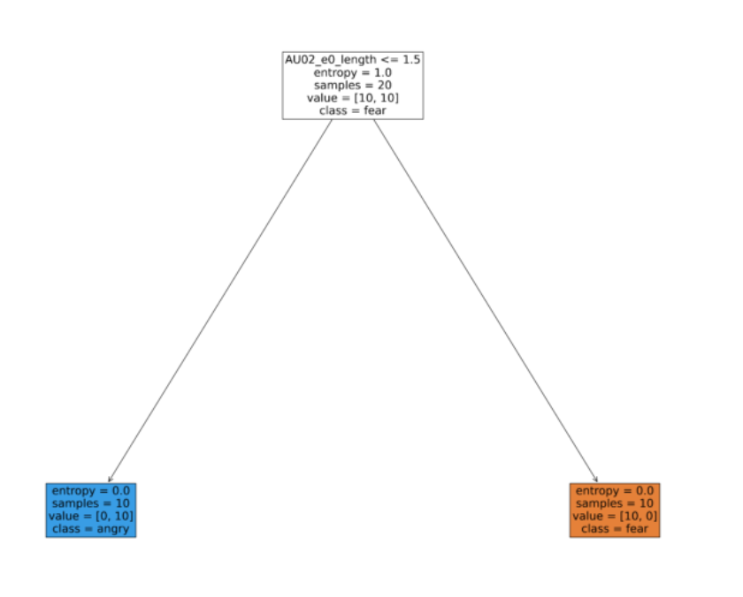
11.5
hearing – classification using fear vs angry:
CV mean results: 0.85
AU’s: 2

Slide 20
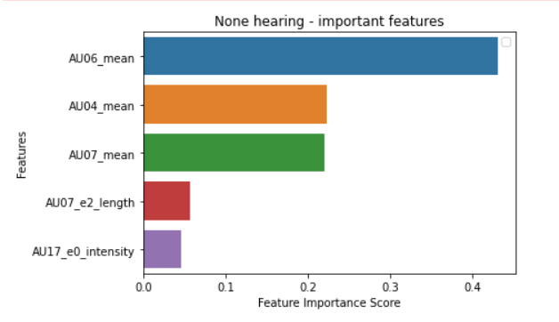
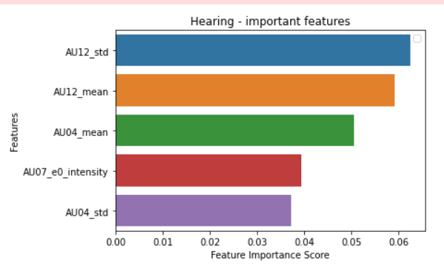
11.5
Classifying emotions - Using random forest:

Slide 21
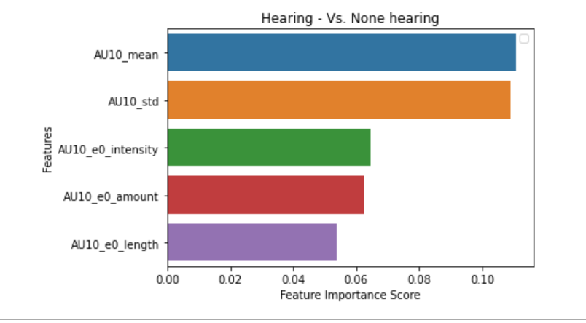
25.5
Classifying hearing vs. none hearing (binary classification task, ignoring the emotions)
CV mean results: 0.97

Slide 22
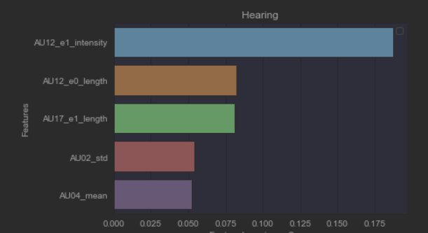
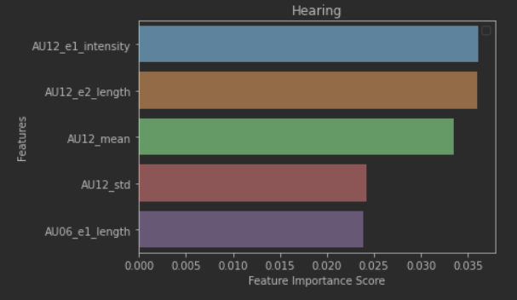
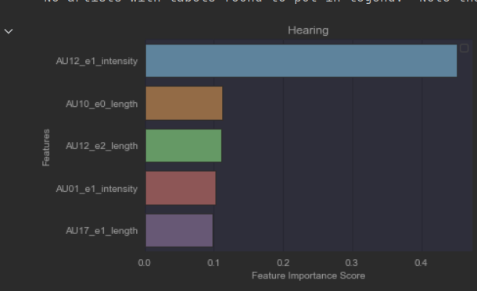
1.6
Using the 120 new videos / sentences – 6 persons - all are hearing
CV classification (via random forest and a single tree) to emotions result are ~0.4
Single tree
Random forest
Single tree – max depth 3
Notes:
Actions: improve classification , error analysis, check if openFace worked good on vids

Slide 23
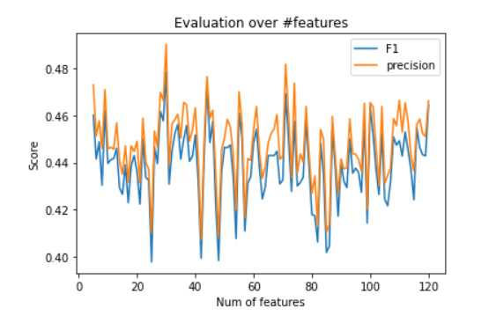
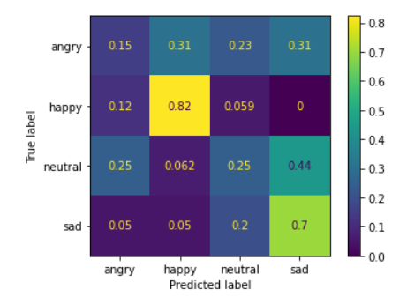
8.6
Using 220 videos - 11 persons (4 emotions) (only hearing people)
Classifying with random forest over #important features (other const parameters are max_depth, entropy, #trees)
0.49 cv score when classifying neutral Vs. angry , and 0.8 for happy Vs. sad
Notes:
Average / cross validate for every feature on the X axis

Slide 24
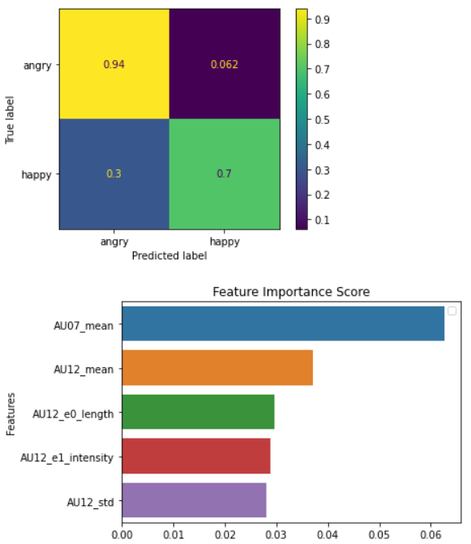
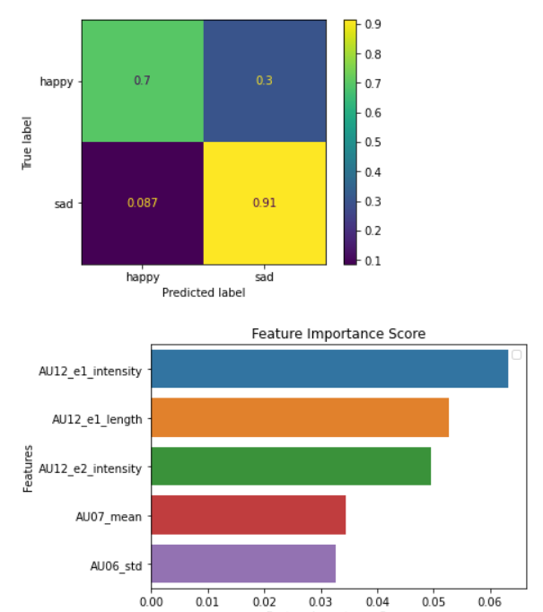
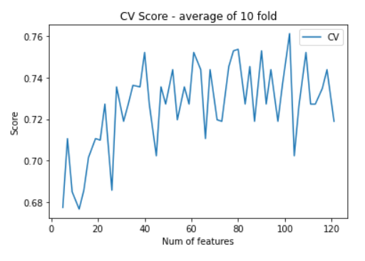
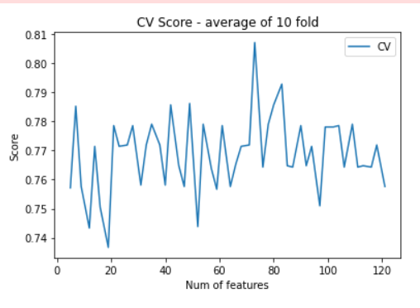
13.6 – hearing only
Using 260 videos - 13 persons (4 emotions) (only hearing people)
Classifying with random forest over #important features (other const parameters are max_depth, entropy, #trees)
Using average cv over x – axis – the #features – to select best clf
Happy vs. sad – 0.8 F1
Happy vs. angry – 0.81 F1

Slide 25
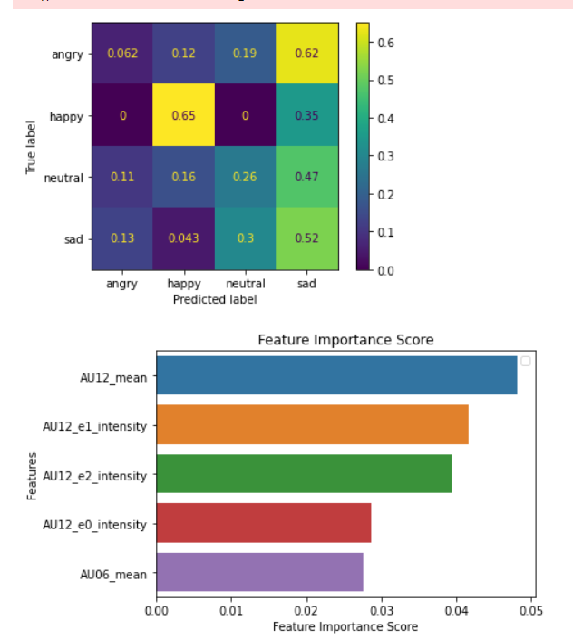
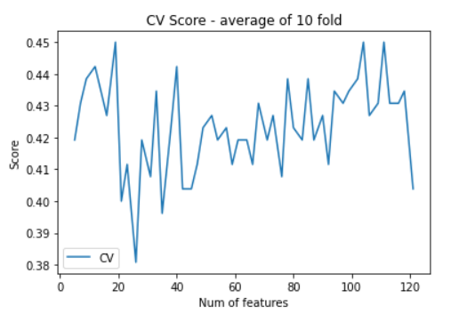
13.6 – hearing emotion

Slide 26
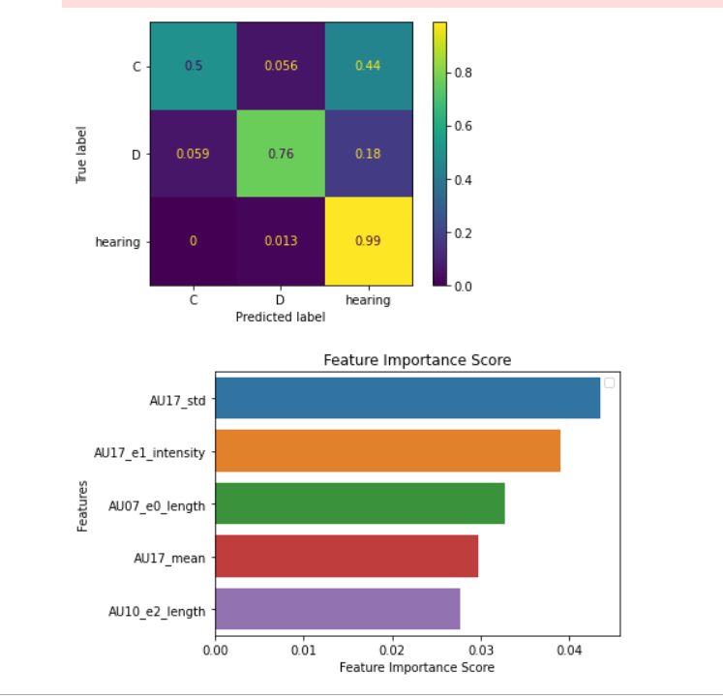
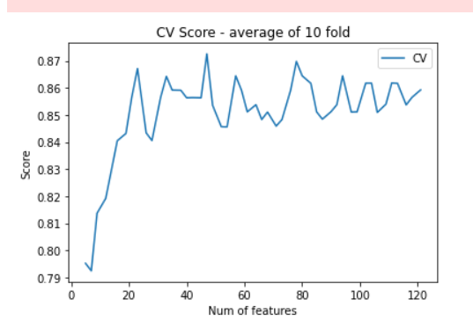
21.6
More data: 260 hearing, 60 Coda, 56 Deaf
Task1: classifying between the 3 groups:
Task2: classifying between emotions in each group
Notes:
Features chosen – 47 - max

Slide 27
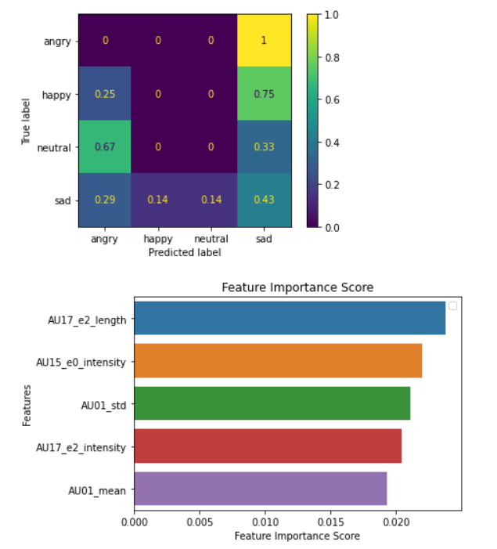
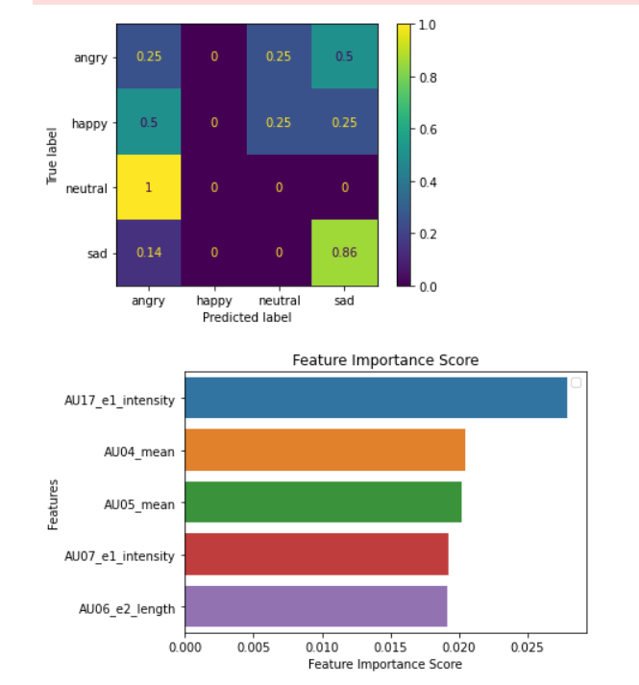
21.6
Task2: classifying between emotions in each group:
hearing – same result from last week – avg cv: 0.4
Deaf: only 56 samples, avg cv score: 0.35
Coda: only 60 samples – avg cv score: 0.25
Deaf
hearing
Coda

Slide 28
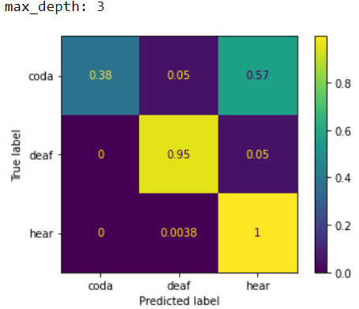
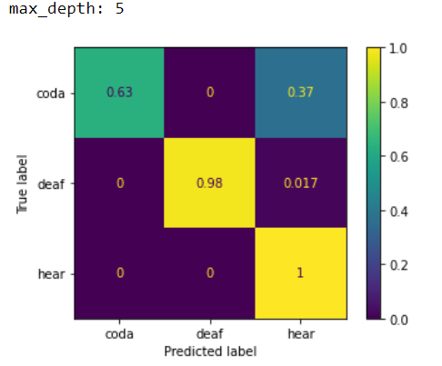
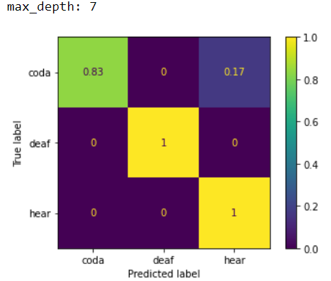
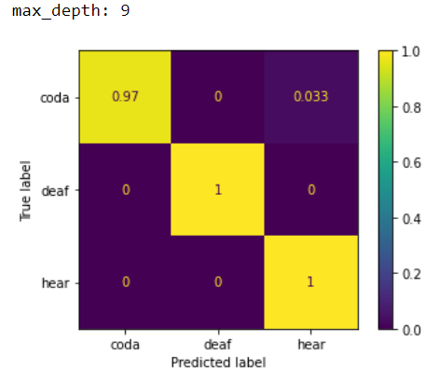
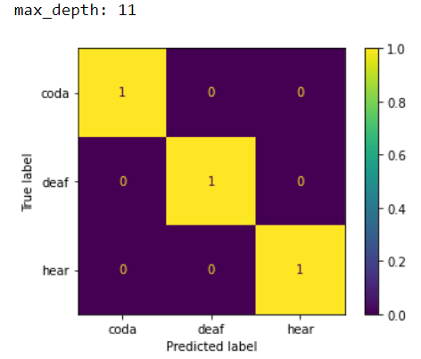
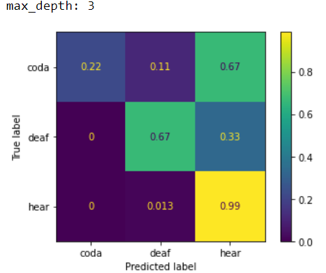
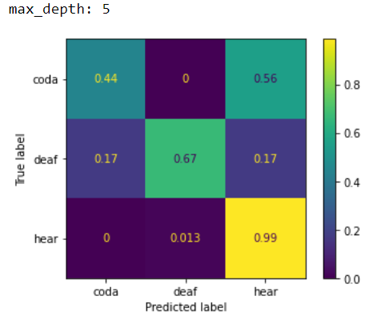
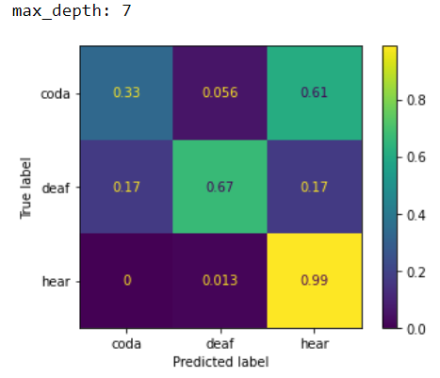
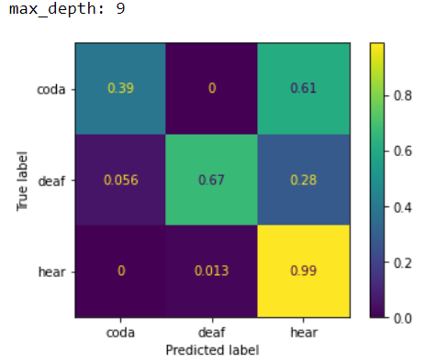
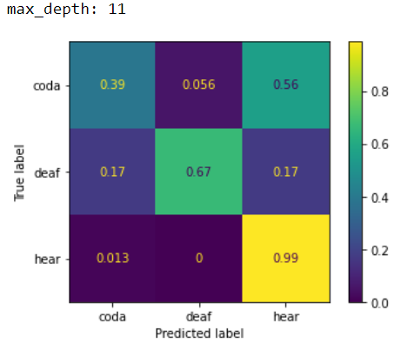
29.6
More data: 260 hearing, 60 Coda, 60 Deaf – data fixed by Sveta (merged coda sign & speak to ‘coda’)
Task1: classifying between the groups:
Task2: classifying between emotions in each group
Overfitting: train = test:
Generalizing: train != test:
Notes:
Note: experiments were done using all features!
Task1 – elaborate
Signing vs speaking
(coda_sign + deaf ) Vs (coda_speak + hear)
אפשר לבדוק את הקודה בטסט סט , על מודל שלמד על
Deaf vs hear

Slide 29
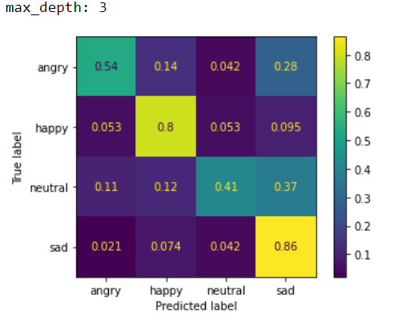
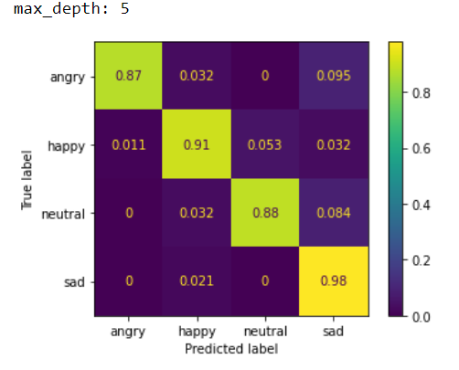
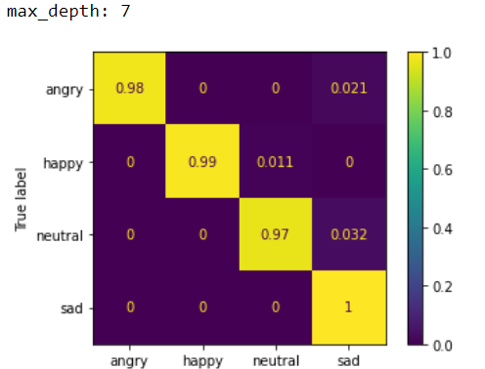





29.6
Task2: classifying between emotions in each group:
Using all 4 groups (380 data samples)
Hearing
Deaf
coda
Overfitting: train = test:
Generalizing: train != test:
Notes:
Note: experiments were done using all features!
Experiment idea:
Merge angry + sad – so 3 clf task
done

Slide 30







29.6
Task2: classifying between emotions in each group:
Using all 4 groups (380 data samples)
Hearing (260 data samples)
Deaf
coda
Overfitting: train = test:
Generalizing: train != test:
Notes:
Note: experiments were done using all features!

Slide 31






29.6
Task2: classifying between emotions in each group:
Using all 4 groups (380 data samples)
Hearing
Deaf (60 samples)
coda
Overfitting: train = test:
Generalizing: train != test:
Notes:
Note: experiments were done using all features!

Slide 32



29.6
Task2: classifying between emotions in each group:
Using all 4 groups (380 data samples)
Hearing
Deaf
Coda – sign ( 40 samples )
Overfitting: train = test:
Generalizing: train != test:
Notes:
Note: experiments were done using all features!

Slide 33
29.6
Generalizing: train != test:
Top row – hearing , bottom row – deaf (60)
Notes:
Note: experiments were done using all features!
Distinguish between neutral vs happy (once for the hearing and one for the signing )

Slide 34


4.7
Experiments ideas:
- task2 - classify emotions - using all 4 groups / Merge angry + sad
- Task1 –classify groups - elaborate Signing vs speaking (coda_sign + deaf ) Vs (coda_speak + hear)
- Distinguish between neutral vs happy (once for the speaking and one for the signing )
Overfitting: train = test:
Generalizing: train != test:
Notes:
380 videos
Overfit – on max depth = 9 – perfect learning
Todo – over sample happy + neutral – 190, 190, 190

Slide 35



4.7
Experiments ideas:
- task2 - classify emotions - using all 4 groups / Merge angry + sad
- Task1 –classify groups - Signing vs speaking (coda_sign + deaf ) Vs (coda_speak + hear)
- Distinguish between neutral vs happy (once for the speaking and one for the signing )
Overfitting: train = test:
Generalizing: train != test:
Notes:
380 videos
Todo: sample features without mouth – not related to speak

Slide 36






4.7
Experiments ideas:
- task2 - classify emotions - using all 4 groups / Merge angry + sad
- Task1 –classify groups - Signing vs speaking (coda_sign + deaf ) Vs (coda_speak + hear)
- Distinguish between neutral vs happy (once for the speaking and one for the signing )
Speaking + signing
Speaking
signing
Generalizing:
train != test:
Overfitting:
train = test:
Notes:
380 videos
Natural and happy => half the videos / samples = 190
Signing only – 50 samples
Speaking only – 140 samples
TODO 1. angry vs happy – same slide
2. New feature vector – normalize each person minus its avg neutral (from 80 samples to 60)

Slide 37


11.7
Experiments ideas:
- task2 - classify emotions - using all 4 groups / Merge angry + sad – oversampling! (190,190,190)
- Task1 –classify groups - elaborate Signing vs speaking (coda_sign + deaf ) Vs (coda_speak + hear)
- Distinguish between neutral vs happy (once for the speaking and one for the signing )
Overfitting: train = test:
Generalizing: train != test:
Notes:
380 videos
Overfit – on max depth = 9 – perfect learning

Slide 38



11.7
Experiments ideas:
- task2 - classify emotions - using all 4 groups / Merge angry + sad
Task1 –classify groups - Signing vs speaking (coda_sign + deaf ) Vs (coda_speak + hear) - without mouth AU’s
removed au’s 10,12,15,17
- Distinguish between neutral vs happy (once for the speaking and one for the signing )
Overfitting: train = test:
Generalizing: train != test:
Notes:
380 videos
(280 speaking, 100 signing)
Todo – histogram of the first imp feature / 2d / 3d map – every person is a point in the space

Slide 39






11.7
Experiments ideas:
- task2 - classify emotions - using all 4 groups / Merge angry + sad
- Task1 –classify groups - Signing vs speaking (coda_sign + deaf ) Vs (coda_speak + hear)
- Distinguish between angry vs happy (once for the speaking and one for the signing )
Speaking + signing
Speaking
signing
Generalizing:
train != test:
Overfitting:
train = test:
Notes:
380 videos
Natural and happy => half the videos / samples = 190
Signing only – 50 samples
Speaking only – 140 samples
2. New feature vector – normalize each person minus its avg neutral (from 80 samples to 60)
Todo : slide for imp features – sad vs neutral and happy vs neutral and angry vs neutral (drop speaking + signing ) 6 for generalizing and 6 for overfitting

Slide 40



28.8
Task1 –classify groups – coda vs deaf vs hear
619 samples / videos - hear 260, coda 220, deaf 139 – D6_1 is missing
Data is not labeled properly – e.g.: C01_03_neutral_ver2.mp4 vs C04_01_angry_sign.mp4
Overfitting: train = test:
Generalizing: train != test:
Notes:
Md 5
Conf matrix below is using the old 380 samples
Sveta:
Name convention is broken in coda – ver2 was added
It seem 1 deaf video is missing-D6_1 angry is missing
Todo:
-add accuracy (no need prec & recall) to each conf matrix
- 3 hist (coda, deaf, hear) of the imp features OR 2d dim -> 1 axis per feature, color per group

Slide 41



28.8
Task2 –classify emotions
619 samples- happy 155, neutral 155, sad 155, angry 154
Overfitting: train = test:
Generalizing: train != test:
Notes:
Md 7

Slide 42


28.8
Task2 –classify emotions – merge angry + sad
619 samples- happy 155, neutral 155, angry_sad - 309
Overfitting: train = test:
Generalizing: train != test:
Notes:
Md 7

Slide 43



28.8
Task2 –classify emotions – merge angry + sad + oversample
619 samples- happy 309, neutral 309, angry_sad - 309
Overfitting: train = test:
Generalizing: train != test:
Notes:
Md 7
Todo: 1.same hist as in slide 40
2. Re run last month experiments after data is fixed – speaking vs signing etc… slide 35,36,39

Slide 44





8.9
Task1 –classify groups – coda vs deaf vs hear
Data is fixed - 559 samples / videos – hear 260, deaf 120, coda_speech 119, coda_sign 60
Accuracy: 0.68. CV score 0.65
Notes:
Only showing Generalizing data (no overfitting)
Rf with max depth 7 used

Slide 45






8.9
Task2 –classify emotions – merge angry + sad + oversample
happy 279, neutral 279, angry_sad – 279
Accuracy: 0.73 CV score: 0.73
Notes:
Prior to oversample we have 140 per emotion

Slide 46






8.9
Sign VS speak:
- Task1 –classify groups - Signing vs speaking (coda_sign + deaf ) Vs (coda_speach + hear)
- Distinguish between neutral vs happy (once for the speaking and one for the signing )
Samples: 379 speaking, 180 signing
Accuracy 0.92 cv score: 0.92
Notes:
Original slide 35

Slide 47















8.9
Sign VS speak:
- Task1 –classify groups - Signing vs speaking (coda_sign + deaf ) Vs (coda_speach + hear)
- Distinguish between neutral vs happy (once for the speaking and one for the signing )
Speaking + signing 0.72
Speaking 0.75
Signing 0.70
Notes:
Origi6al slide 36
Natural and happy => half the videos / samples = 190
Signing only – 90 samples
Speaking only – 190 samples

Slide 48















8.9
Sign VS speak:
- Task1 –classify groups - Signing vs speaking (coda_sign + deaf ) Vs (coda_speach + hear)
- Distinguish between Angry vs happy (once for the speaking and one for the signing )
Speaking + signing
Speaking 0.75
Signing 0.85
Notes:
Origi6al slide 39
Natural and happy => half the videos / samples = 190
Signing only – 90 samples
Speaking only – 190 samples
Add :
sad vs neutral
angry vs neutral
Download D-1-3

Slide 49





13.9
Task1 –classify groups – coda vs deaf vs hear
Data is fixed - 674 samples / videos – hear 260, deaf 178, coda_speech 137, coda_sign 99
Accuracy: 0.67. CV score 0.61
Notes:
Only showing Generalizing data (no overfitting)
Rf with max depth 7 used

Slide 50





13.9
Task2 –classify emotions – merge angry + sad + oversample
happy 336, neutral 336, angry_sad – 336
Accuracy: 0.78 CV score: 0.75
Notes:
Prior to oversample we have 169 per emotion

Slide 51






13.9
Sign VS speak:
- Task1 –classify groups - Signing vs speaking (coda_sign + deaf ) Vs (coda_speach + hear)
- Distinguish between neutral vs happy (once for the speaking and one for the signing )
Samples: 397 speaking, 277 signing
Accuracy 0.92 cv score: 0.9
Notes:
Original slide 35

Slide 52















13.9
Sign VS speak:
- Task1 –classify groups - Signing vs speaking (coda_sign + deaf ) Vs (coda_speach + hear)
- Distinguish between neutral vs happy (once for the speaking and one for the signing )
Speaking + signing 0.75
Speaking 0.83
Signing 0.69
Notes:
Origi6al slide 36
Natural and happy => half the videos / samples = 169
Signing only – 139 samples
Speaking only – 199 samples

Slide 53















13.9
Sign VS speak:
- Task1 –classify groups - Signing vs speaking (coda_sign + deaf ) Vs (coda_speach + hear)
- Distinguish between Angry vs happy (once for the speaking and one for the signing )
Speaking + signing 0.7
Speaking 0.63
Signing 0.83
Notes:
Origi6al slide 39
Natural and angry => half the videos / samples = 169/170
Signing only – 140 samples
Speaking only – 199 samples
Add :
sad vs neutral
angry vs neutral
Download D-1-3

Slide 54









13.9
Sign VS speak:
- Task1 –classify groups - Signing vs speaking (coda_sign + deaf ) Vs (coda_speach + hear)
- Distinguish between Angry vs neutral (once for the speaking and one for the signing )
Speaking + signing 0.7
Speaking 0.48
Signing 0.64
Notes:
Origi6al slide 39
Natural and angry => half the videos / samples = 169/170
Signing only – 140 samples
Speaking only – 200 samples
Add :
sad vs neutral
angry vs neutral
Download D-1-3

Slide 55










13.9
Sign VS speak:
- Task1 –classify groups - Signing vs speaking (coda_sign + deaf ) Vs (coda_speach + hear)
- Distinguish between sad vs neutral (once for the speaking and one for the signing )
Speaking + signing 0.63
Speaking 0.53
Signing 0.8
Notes:
Origi6al slide 39
Natural and angry => half the videos / samples = 169/166
Signing only – 137 samples
Speaking only – 198 samples
Add :
sad vs neutral
angry vs neutral
Download D-1-3

Slide 56
13.9
Sign VS speak:
- Task1 –classify groups - Signing vs speaking (coda_sign + deaf ) Vs (coda_speach + hear)
- Distinguish between sad vs neutral (once for the speaking and one for the signing )
Speaking + signing 0.63
Coda speech, 0.53
deaf 0.8
Notes:
4 original groups ->each label vs neutral

